Slide 1
Welcome to Helsinki Finland Ministry of the Interior!
CRISPRO-Project
28.03.2022

Slide 2
Networking and the Rescue Services in Finland
CRISPRO 28.03.2022
Mr Jari Honkanen, senior specialist

Slide 3
Changes in the operative environment
Inequality
incidents and accidents concentrate, areas and regions grow inequal
Aging population
number of accidents grow, task profiles change
Sparesly populated region >< growing areas
concentration in few city-areas, operational and capable staff, preparedness
Technological development
dependance on electricity and technology, knowledge
Climate change
extreme weather conditions and preparing for them
Inter-dependence grows
need for cross-sectoral planning and cooperation
Change in the safety environment

Slide 4
Engaging – Networking - Cooperating
Fundament is build on:
+ Knowing eachother
engaging all stakeholders, partners, actors having some role at some stage
+ Equality and respect
respect for different roles and mandates
auhtorities – legal fundament
organisations – representing citizens and democracy
private sector providing services and goods
education trains the capabilities for preparedness
research supports with facts and information
+ Transparency
+ Trust
= Capability for cooperation as a network – strength of a strong civil society
Examples: Support to Ukraine, UN-cooperation and BSR-cooperation

Slide 5
Rescue services in Finland
General command lies on Rescue Authority
Accident prevention.
Rescue operations.
Preparedness and civil protection
Ready to deal with all types of incidents
— from the very minor
to major disasters —
Close to citizens

Slide 6
Tasks of Rescue Services
Rescue Services
Accident prevention
Prevention of fires and other accidents.
The cooperation with other authorities and communities and the inhabitants.
Fire fighting and rescue services
Actions needed to protect and save life, property and the environment, to limit damages and to alleviate the consequences in all kind of accidents
EMS (Emergency Medical Services)
Civil protection
Monitoring, alarming, evacuating, protecting and rescuing of population in war-related situations.

Slide 7
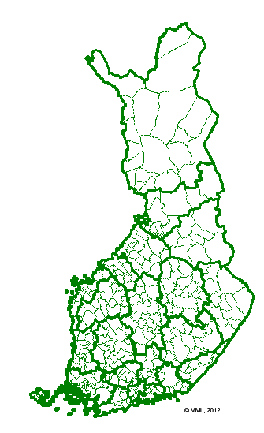
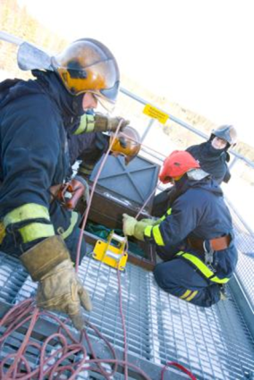
Municipalities are jointly responsible for rescue services in rescue service regions. Since 2004 there have been 22 rescue regions in Finland, which carry out rescue service duties in their regions. In operations, rescue departments may be assisted by contract fire brigades, whether volunteer, institutional, industrial or military.
Regions
22 Rescue service regions,
800 Voluntary fire brigades ,
industrial and institutional fire brigades
Notes:
Vahvat itsenäiseen toimintaan kykenevät pelastuslaitokset.
Velvoite suunnitella yhteistoiminta ja avunantojärjestelyt naapurilaitosten kanssa.

Slide 8
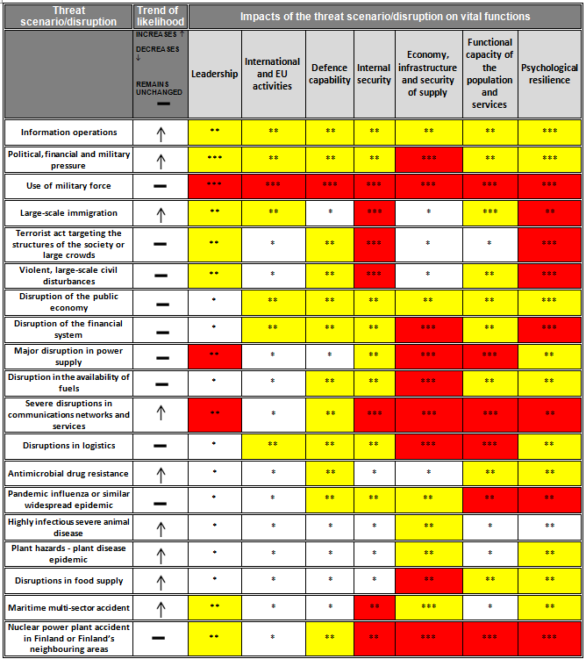
Resources in fire and rescue services
Fire stations
830
Economic
501 M€
Vehicles
5490
Number of tasks in a year
104 411
Personal resources
22 500

Slide 9
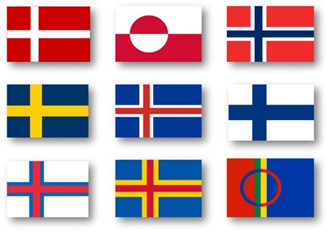
International coopeation and activities of Rescu Services
Giving and receivinf international support
Developing internationl rescue activities
Implementing international rescue resources in national preparedness
UN: OCHA, EU: ERCC
Host Nation Support -arrangements
3. Nato Civil preparedness cooperation
As the responcible authority, cooperation with MFA/NAE, Nato civil preparedness committee CEPC (DG), Nato –experts
4. Bilateral affairs
Estonia-cooperation
USA-cooperation
(Russia-cooperation)
2. EU-cooperation
Civil Protection cooperation
Participating and acting in the UCPM
using the UCPM funding programmes in developing
national resources (CBRN, forest fire)
5. Regional cooperation
Nordic civil preparedness cooperation
Barents region cooperation (incl. Barents Rescue –exercises)
Baltic Sea Region cooperation (Council of Baltic Sea States)
Arctic Region cooperation (Arctic Council/EPPR)

Slide 10
BASIC PRINCIPLES IN CRISIS MANAGEMENT IN FINLAND
Comprehensive approach - Integration of preparations for peace-time and war-related emergencies
All actors are responsible for carrying out their functions in all security situations
Close and pragmatic public/private cooperation, military authorities included
Application of modern technology
Participation in International Civil Protection Assistance (EU, UN)

Slide 11
Thank You!

